Slide 1
FRAUD DETECTION
Abagnale Inc.
Philippe Beliveau 40098503
Matthew Cuyler 40124941
David Desjardins 40110137
BSTA 478 Section AA

Slide 2
PLAN
Our objectives
Get to know our data
1st Try - The insufficiency of Tree Algorithm
2nd Try - K-Means
3rd Try - Autoencoders to the rescue
Discussion and further improvement

Slide 3
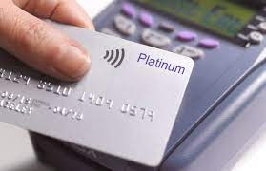
INTRODUCTION
$28.65B lost to credit card fraud in 2019
Acceleration of computerized fraud detection since 90s
Problem: Signaling fraud while minimizing disrupting customers with false positives

Slide 4
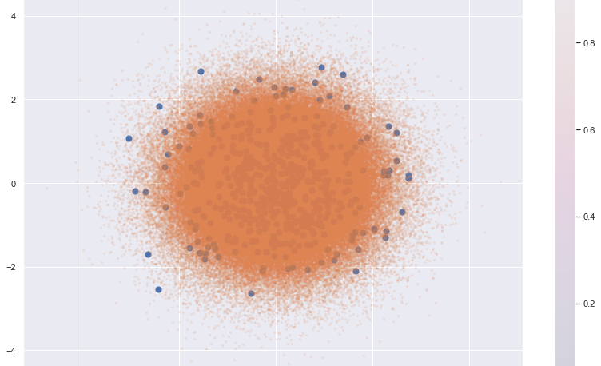

OBJECTIVE FRAUD DETECTION
NON-FRAUD
FRAUD

Slide 5
Other fraud detection models:
Patil, S., Nemade, V., &amp; Soni, P. K. (2018). Predictive modelling for credit card fraud detection using data analytics. Procedia Computer Science, 132, 385–395. https://doi.org/10.1016/j.procs.2018.05.199
Methods:
Logistic Regression, Accuracy: 72%
Decision Tree, Accuracy 72%
Random Forest Decision Tree, Accuracy 76%
Patil, S., Nemade, V., &amp; Soni, P. K. (2018). Predictive modelling for credit card fraud detection using data analytics. Procedia Computer Science, 132, 385–395. https://doi.org/10.1016/j.procs.2018.05.199
Method:
Combination of
Rule-based filter
Dempster-Shafer Adders
Bayesian Learner
Overall 98% TP and 10% FP (in different optimizations)
Other fraud detection models with our dataset:
Over 3600 model commits for our specific dataset, with 100 discussions. The leading model has a 97% recall by undersampling and using a neural network
Notes:
First paper lacked depth
Second paper demonstrated a far more intricate system, but it lacked transparency in terms of it’s results:
it is usually seen that fraudsters often try to derive maximum benefit from a card by either making high value purchases with longer time gaps or small value purchases at smaller time gaps to avoid detection
From these two papers, we found that a single model approach will not suffice to accurately report fraud, but instead a fusion model may yield more accurate results.

Slide 6
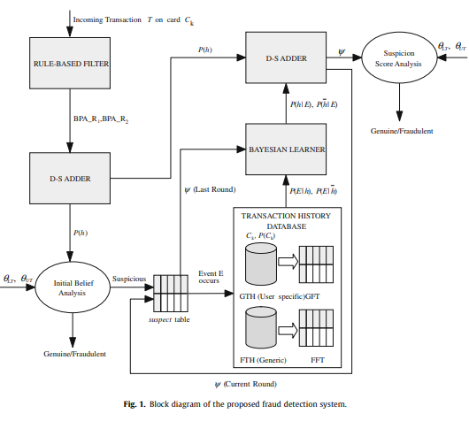
Notes:
https://www.cnbc.com/2021/01/27/credit-card-fraud-is-on-the-rise-due-to-covid-pandemic.html:
In 2019, worldwide credit card fraud reached 28.65B USD
Evidently, credit card fraud is a field with millions, if not billions of dollars invested. Although a group of 3 students may not be able to create the world’s leading state of the art fraud detection model, we hope our model can atleast be used to add data and accuracy to the suspicion pools.

Slide 7
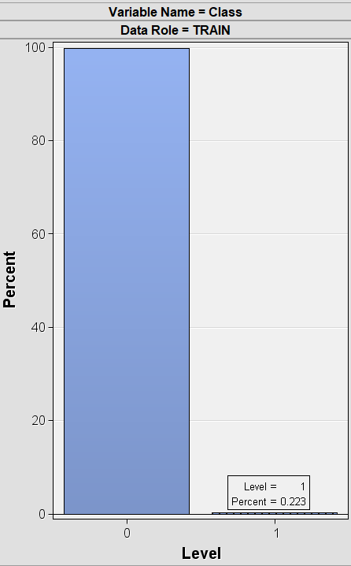
OUR DATASET
Under-representation of fraudulent transactions. (0.223% of Observations)
0 Missing values.
From a t-test, we found all variables to be significant.
Has class (binary: non-fraudulent/fraudulent), Time (seconds elapsed from the first transaction in the set), amount, and 28 variables from PCA.
The dataset has 284807 Observations and 31 variables.
284315 non-fraudulent observations
492 fraudulent observations
Notes:
Evidently, credit card fraud is a field with millions, if not billions of dollars invested. Although a group of 3 students may not be able to create the world’s leading state of the art fraud detection model, we hope our model can atleast be used to add data and accuracy to the suspicion pools.
In our set, fraudulent transactions are on average, of larger amounts than non-fraudulent, however, the median size is significantly lower as well, indicating support for this statement.
In addition, the time variable (which is not duration between transactions but instead a fixed time) we saw a significantly higher standard deviation which indicates a lower frequency between fraudulent transactions.

Slide 8
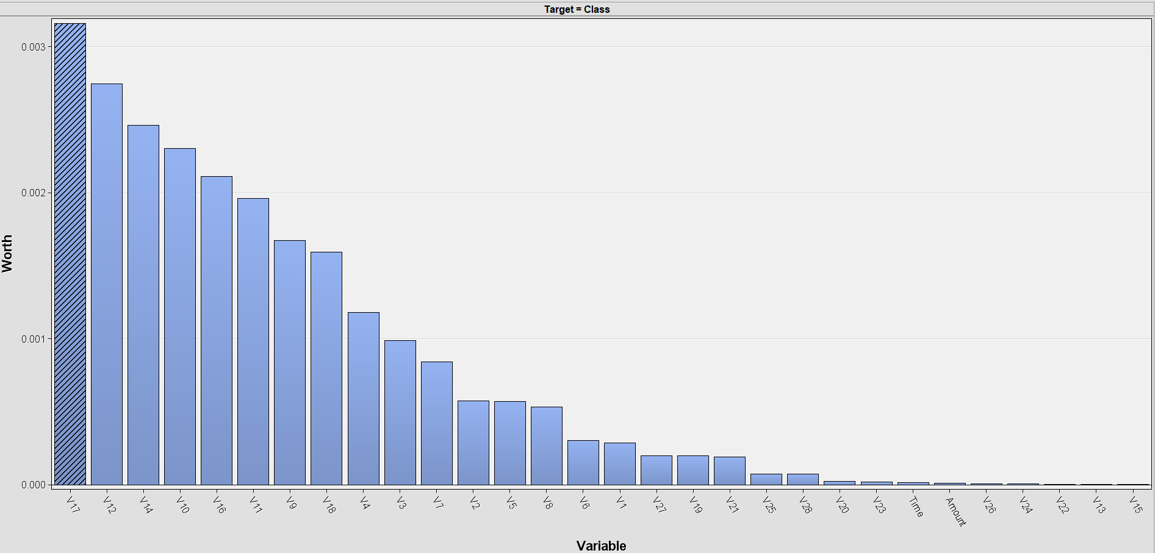
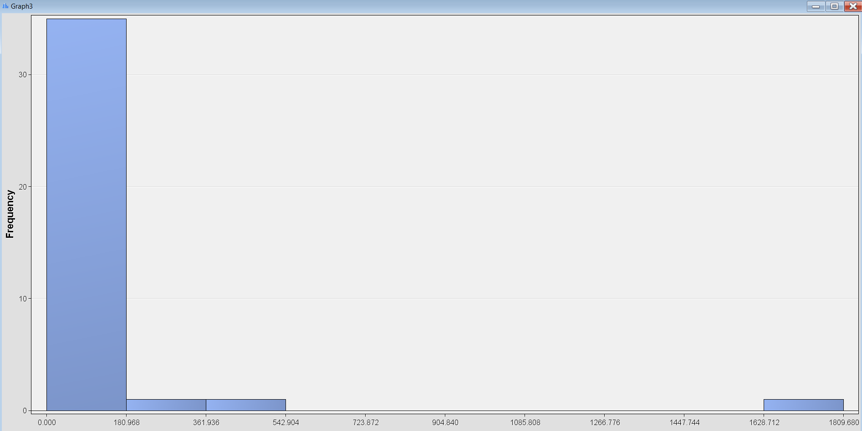
EXPLORATORY DATA ANALYSIS (EDA)
Fraudulent transactions occur mostly at low amounts (<$9.20).
Although extremely infrequent, there are fraudulent transactions reaching up to $2125.87.
Highest |correlation| was ~0.003 with V17.
Fraudulent mean amount: $122
Non-fraudulent mean amount: $98
Fraudulent STDev time: 47835 sec
Non-fraudulent STDev time: 17044 sec
Notes:
Evidently, credit card fraud is a field with millions, if not billions of dollars invested. Although a group of 3 students may not be able to create the world’s leading state of the art fraud detection model, we hope our model can atleast be used to add data and accuracy to the suspicion pools.
it is usually seen that fraudsters often try to derive maximum benefit from a card by either making high value purchases with longer time gaps or small value purchases at smaller time gaps to avoid detection
In our set, fraudulent transactions are on average, of larger amounts than non-fraudulent, however, the median size is significantly lower as well, indicating support for this statement.
In addition, the time variable (which is not duration between transactions but instead a fixed time) we saw a significantly higher standard deviation which indicates a lower frequency between fraudulent transactions.

Slide 9
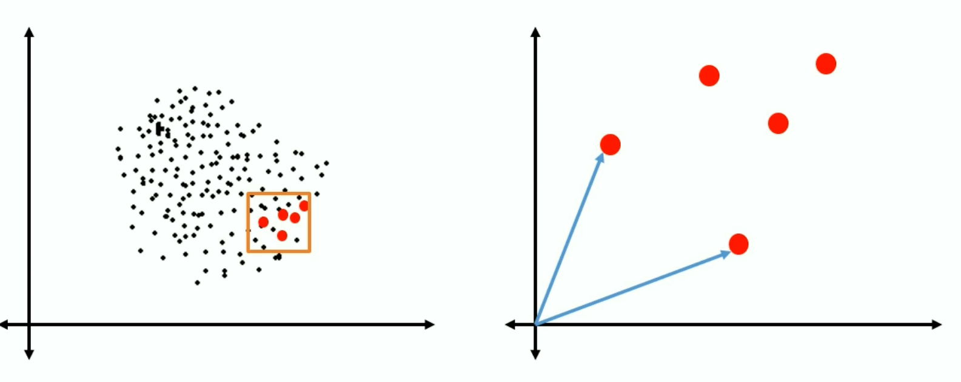
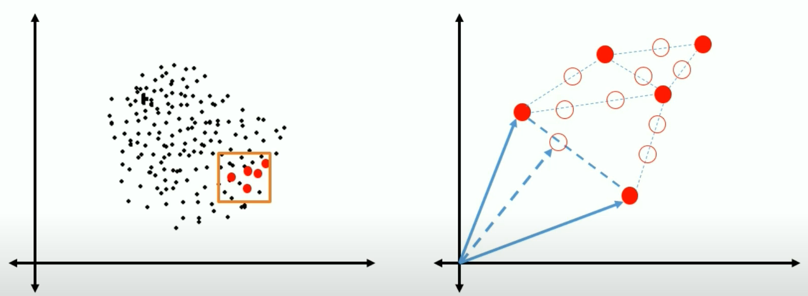
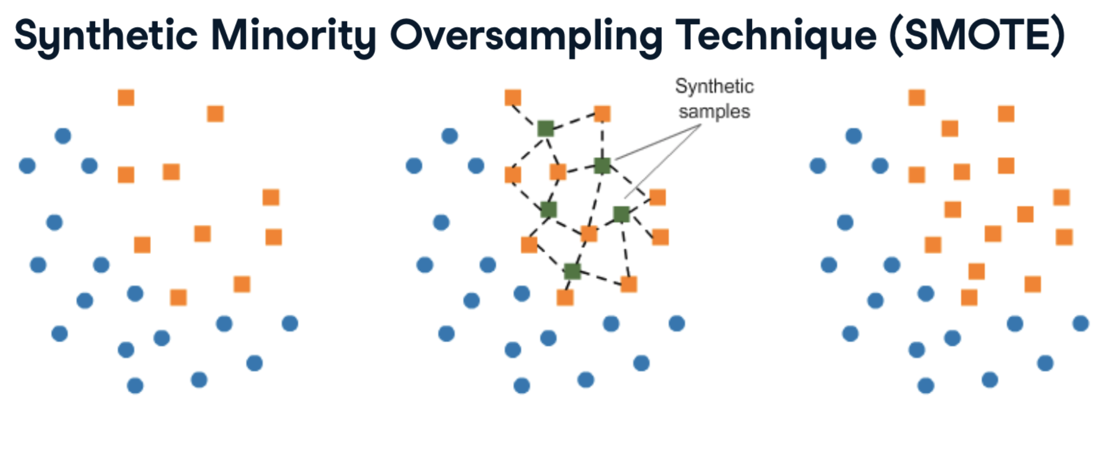
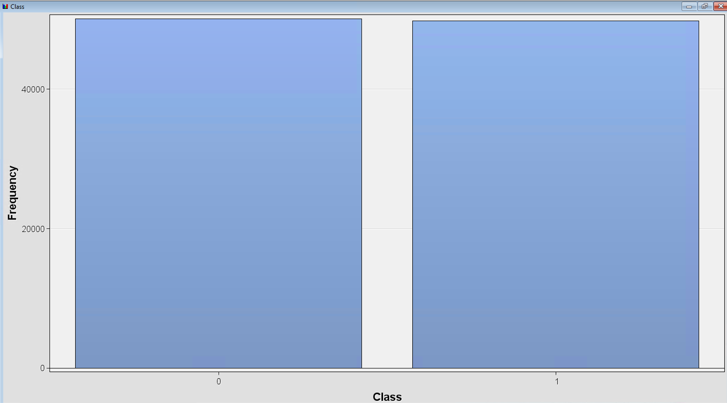
HOW TO OVERCOME THE UNDERREPRESENTATION OF FRAUD
Drawbacks:
We found our fraud observations to be very dispersed.
When recreating observations using nearest neighbor / cluster, SMOTE technique appears not perfectly suited to the situation.
After resampling we reach a near 50/50 ratio
Notes:
Your goal is to better train your model by giving it balanced amounts of data. Your goal is not to predict your synthetic samples.
Synthetic Minority Oversampling Technique (SMOTE)
The Synthetic Minority Oversampling Technique, or SMOTE, is another way of adjusting the imbalance by oversampling your minority observations, aka your fraud cases. But with SMOTE, we're not just copying the minority class. Instead, as you see in this picture, SMOTE uses characteristics of nearest neighbors of fraud cases to create new synthetic fraud cases, and thereby avoids duplicating observations.
Which resampling method to use?
You might wonder which one of these methods is the best? Well, it depends very much on the situation.
If you have very large amounts of data, and also many fraud cases, you might find it computationally easier to undersample, rather than to increase data even more. But in most cases, throwing away data is not desirable. When it comes to oversampling, SMOTE is more sophisticated as it does not duplicate data. But this only works well if your fraud cases are quite similar to each other. If fraud is spread out over your data and not very distinct, using nearest neighbors to create more fraud cases introduces a bit of noise in the data, as the nearest neighbors might not necessarily be fraud cases.

Slide 10
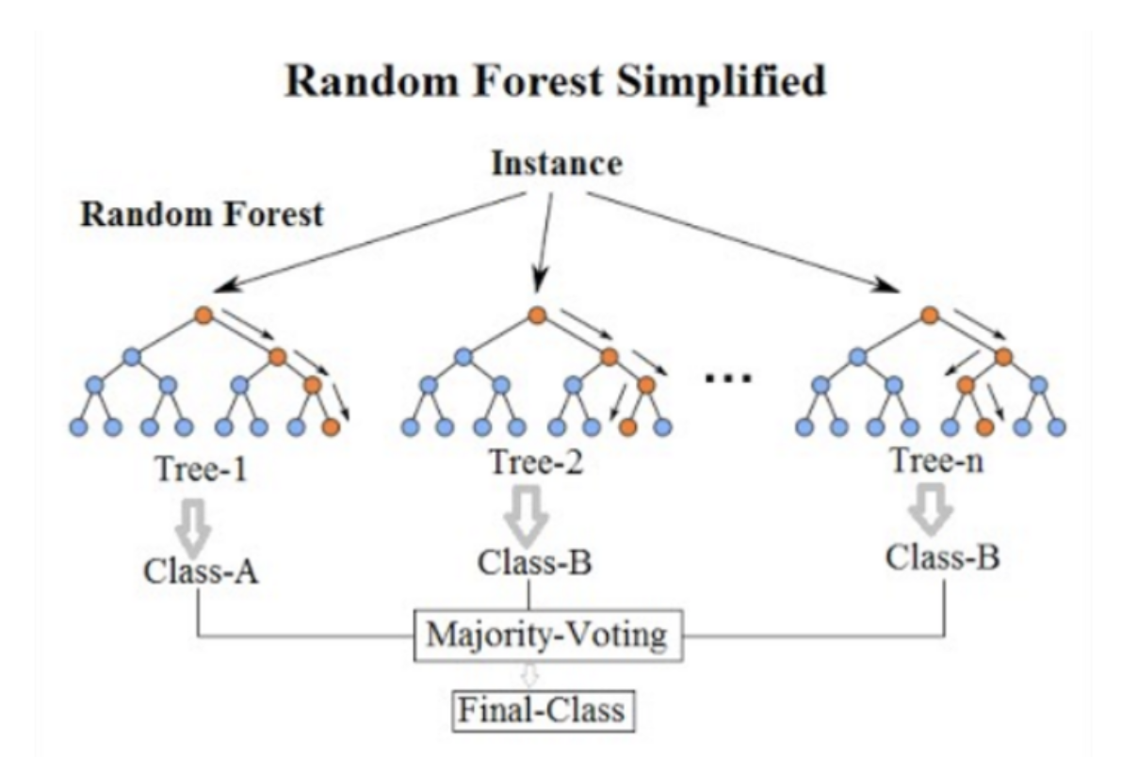
1ST TRY: TREE ALGORITHM

Slide 11
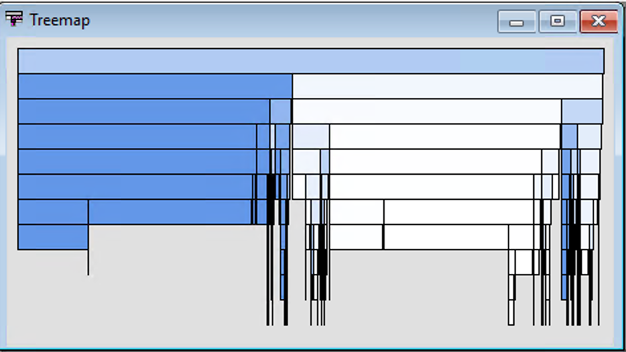
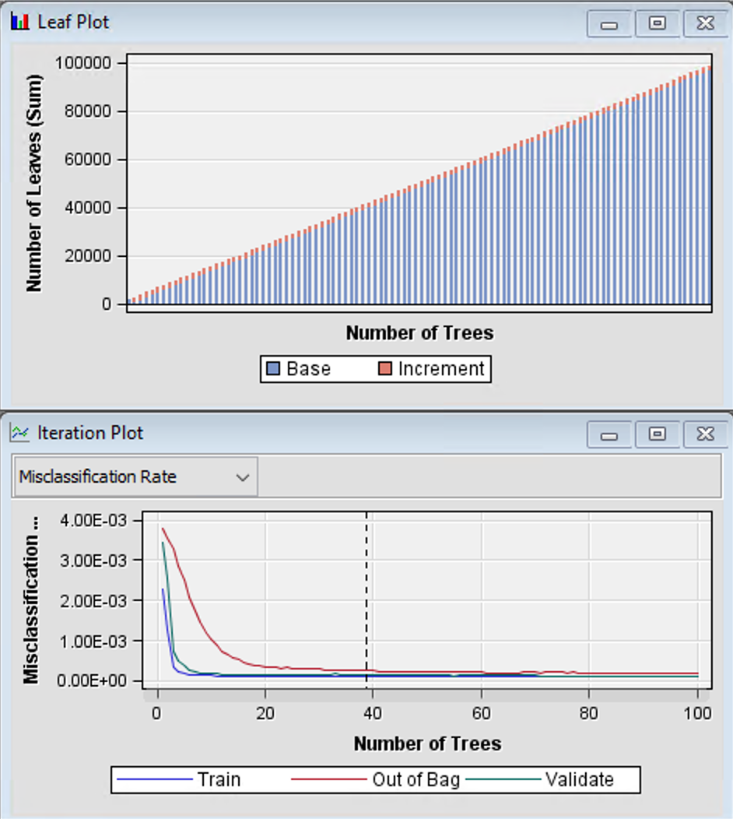
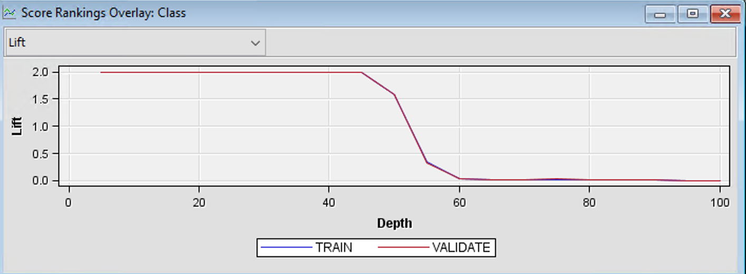
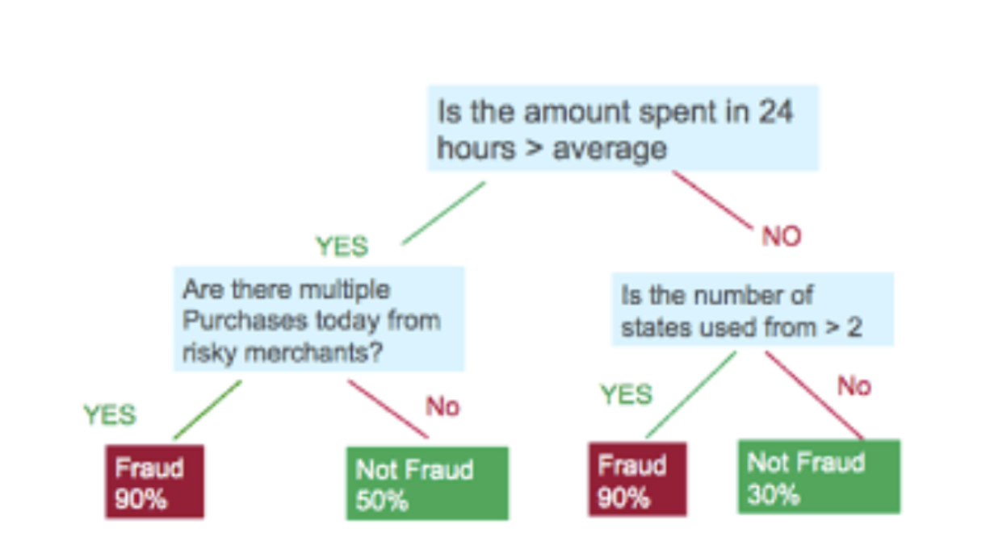
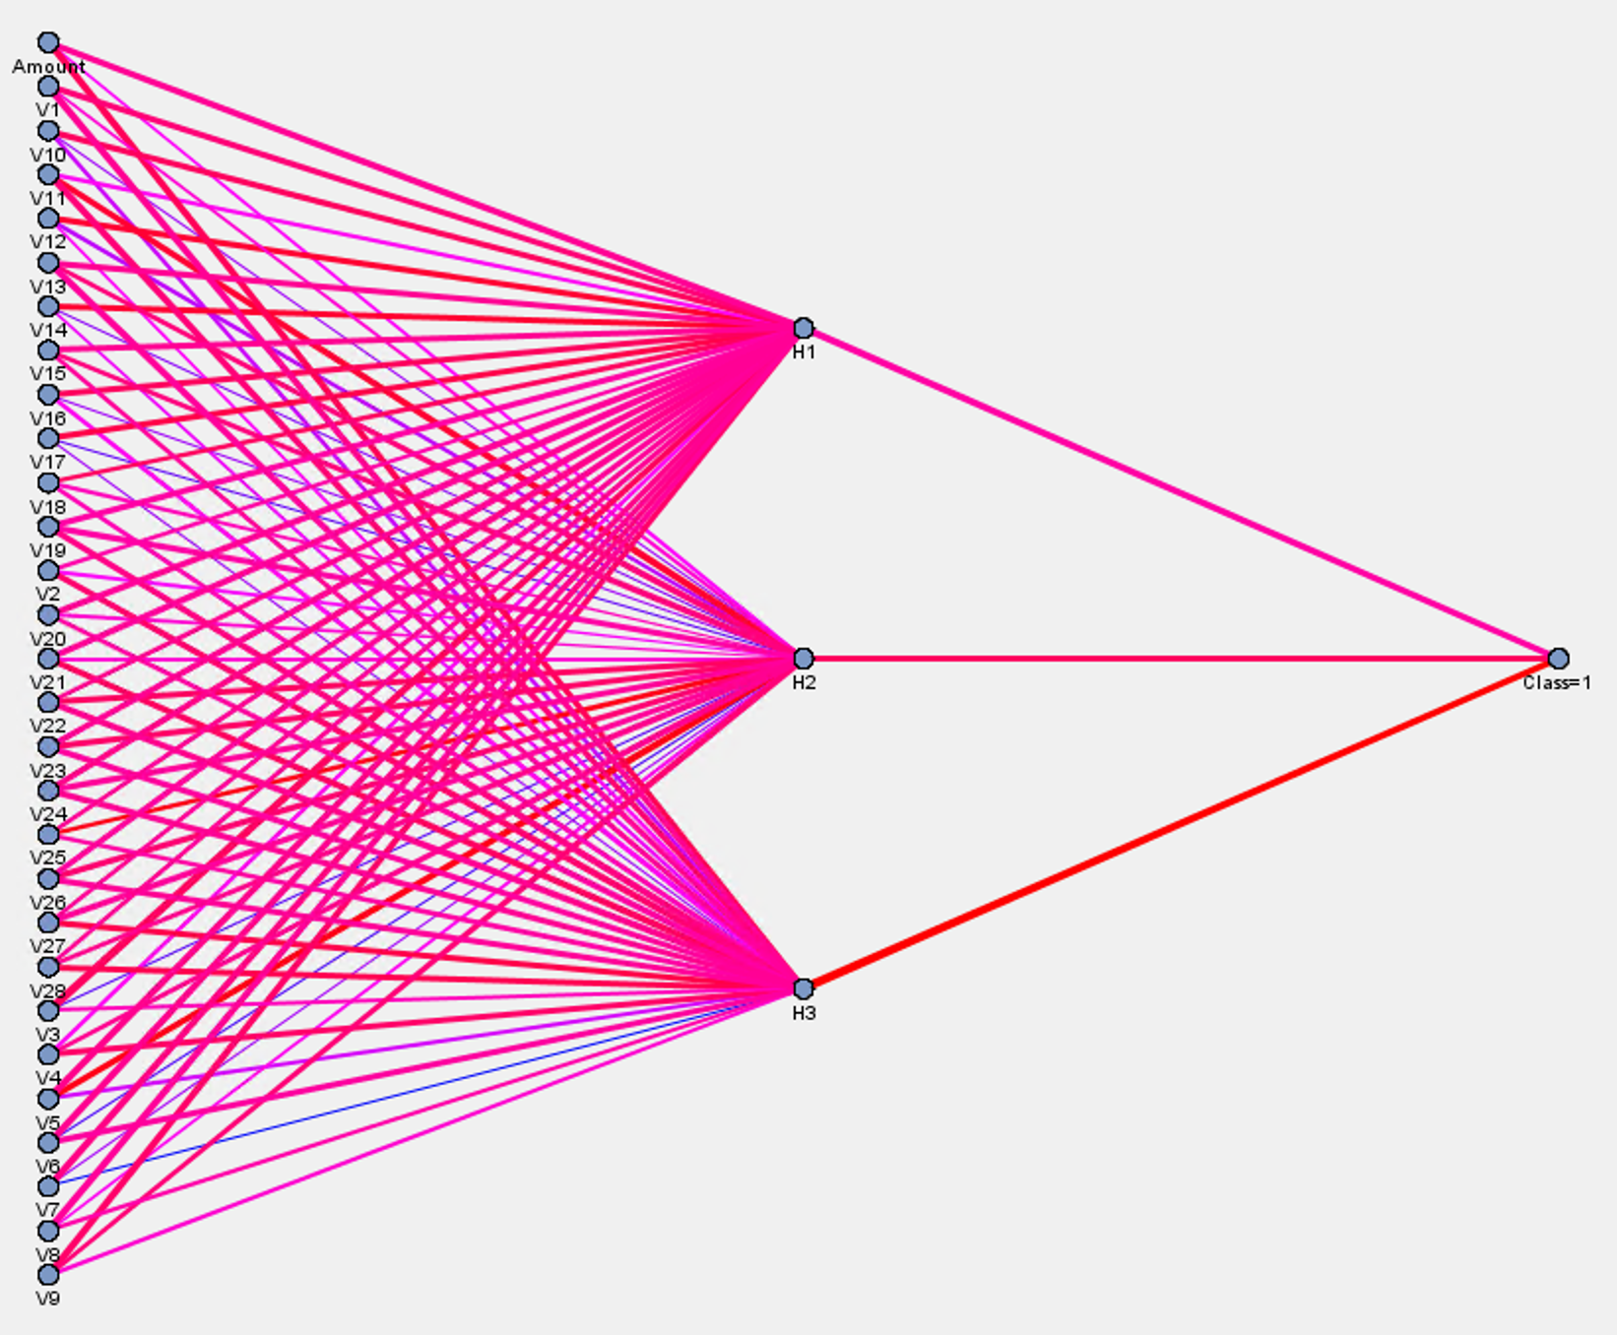
TESTED ALGORITHMS
At this stage we tested several decision trees, a random forest, as well as a neural network and logistic regression

Slide 12
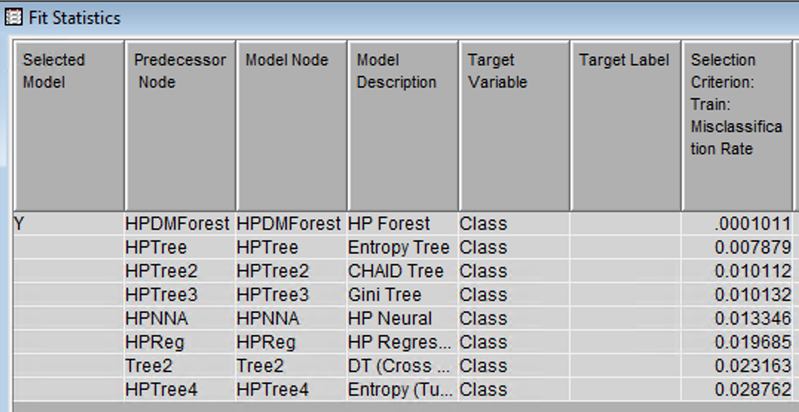
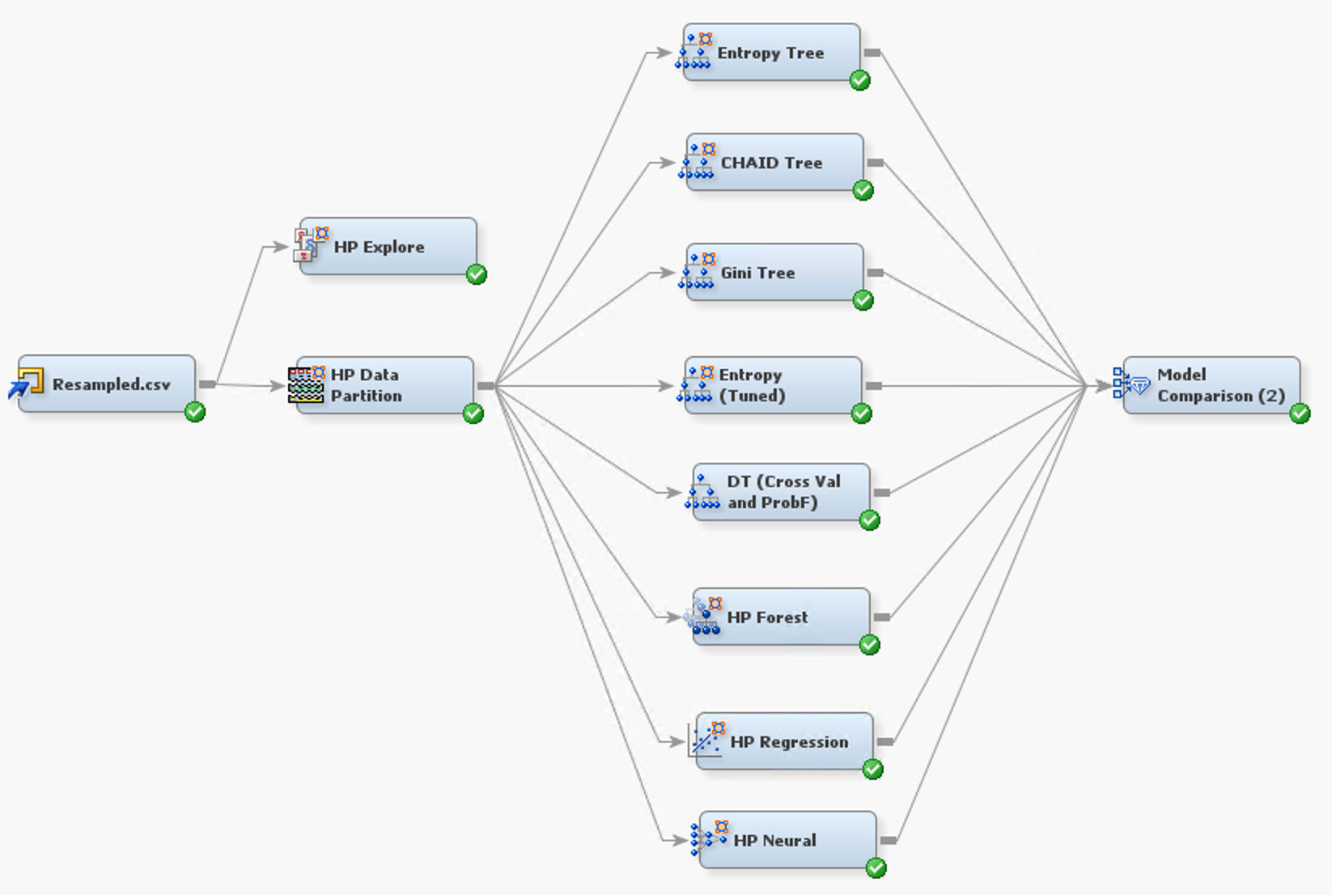
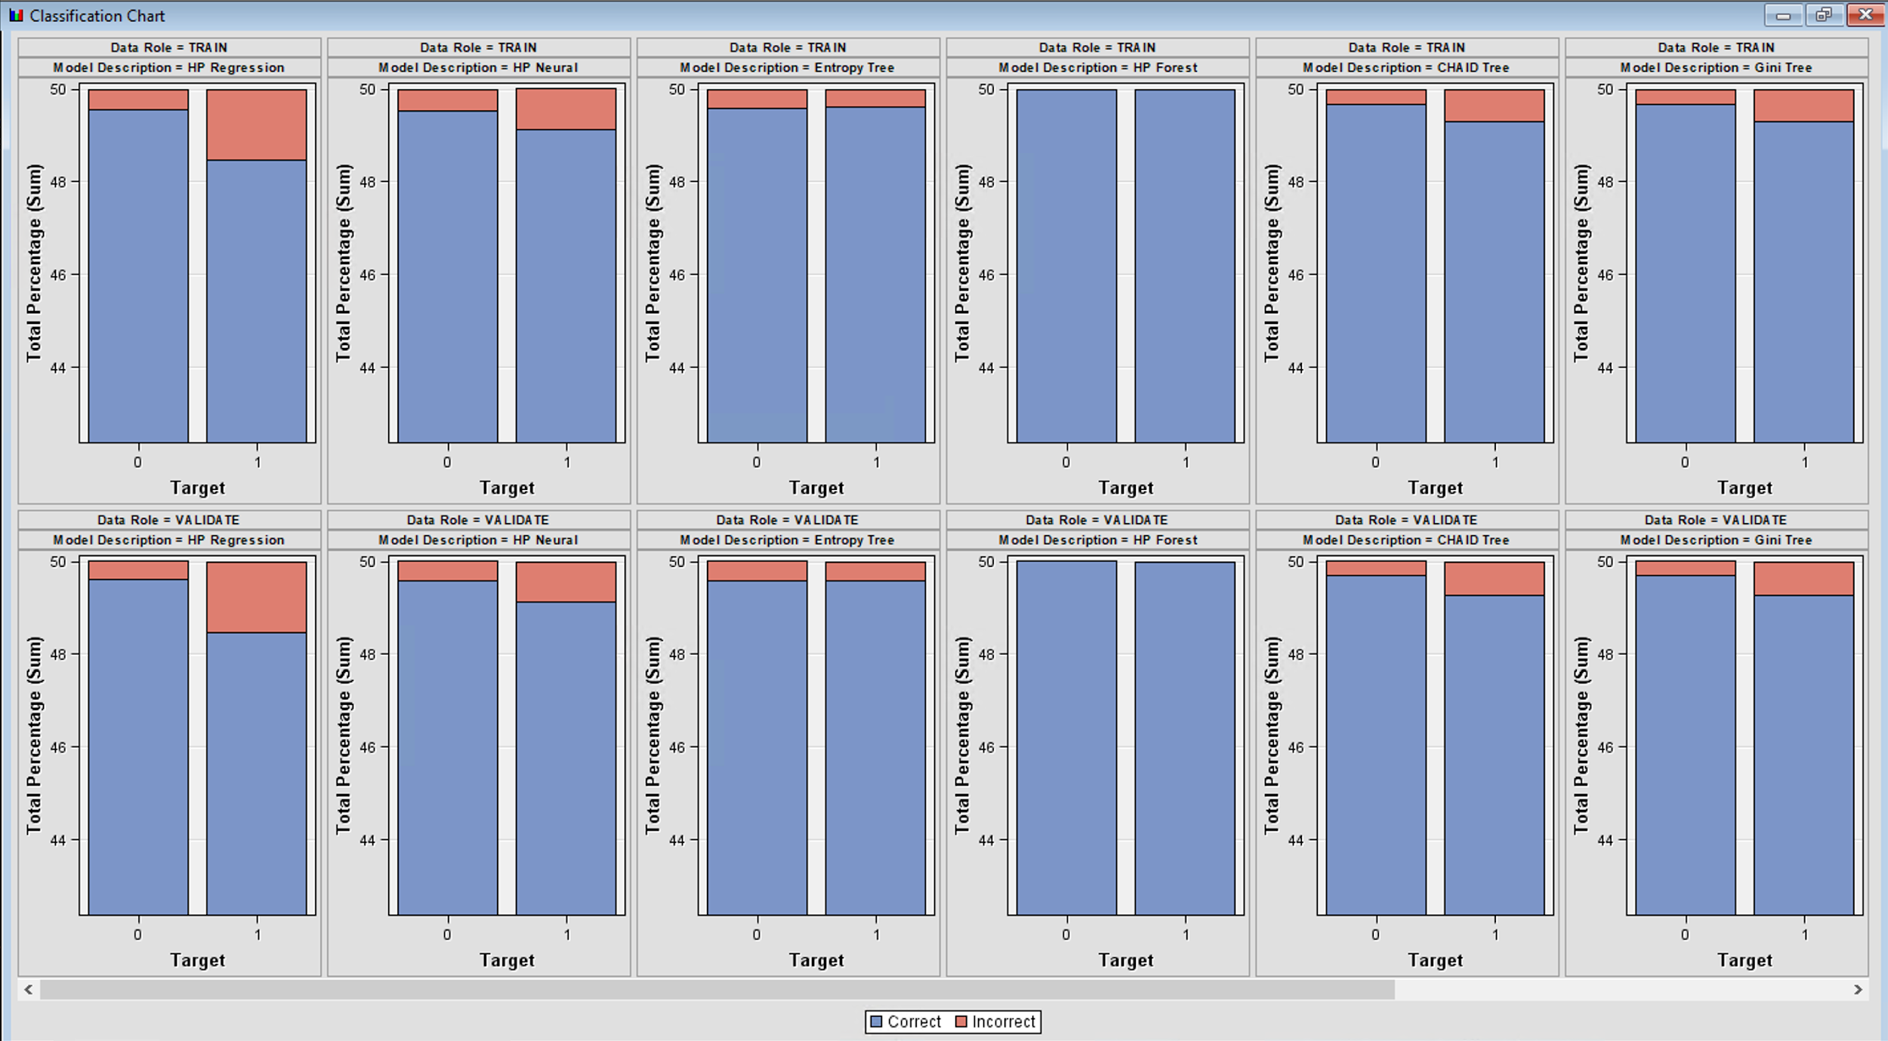
OUR RESULTS
Although it may show at first glance that the Random Forest was able to predict fraud with very high accuracy. These numbers don’t always give us a final interpretation.
Notes:
Accuracy isn’t everything when working on fraud detection
Your goal here is to quickly show how shitty your prediction are so that we can show the relevance of using other model
Need to see the classification rate clearly
Don’t see anything on the image

Slide 13
IS TREE ENOUGH FOR THIS TASK?
Maybe, but we believe there are more efficient alternatives

Slide 14
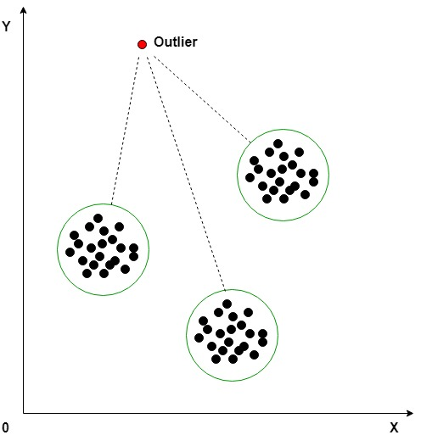
2ND TRY: K-MEANS CLUSTER ANALYSIS
Notes:
Having done and realize the difficulty to perform fraud detection with Sas algorithm on this dataset.
We are doing a second try using KMeans algorithm to perform cluster analysis.

Slide 15
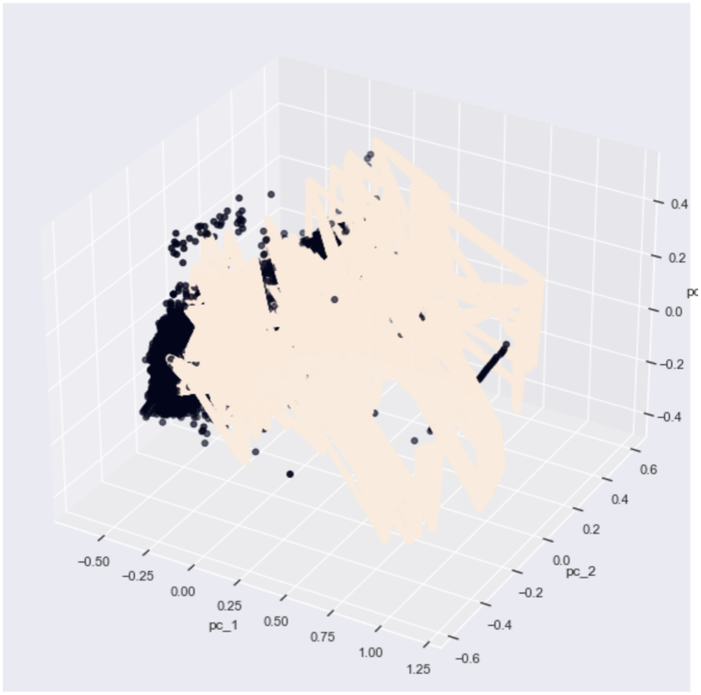
DIMENSIONALITY REDUCTION PCA
Data resampled
Seems to pertain in a region somewhat unique, so there is potential to perform cluster analysis
Fraud
Non-Fraud
Notes:
The first thing we should do before considering Cluster analysis is to visualize our data in a lower dimensional space to see if we can actually cluster our observation.
Using the PCA algorithm we have been able to visualize in tree dimension our data, without resampling it we couldn’t have a clear visual of the Fraud observation, thus we had to resampled it with the SMOTE technique presented earlier.
After resampling we are now in a better position to visualize how the cluster are form and we see that most of the fraudulent observations are on the right of the space and are higher. This means that there is potential to perform cluster analysis.

Slide 16
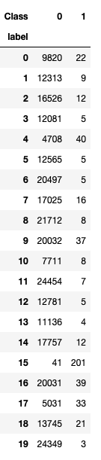
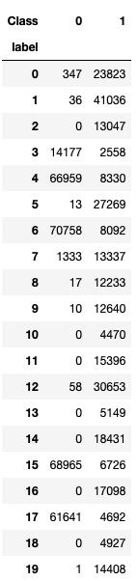
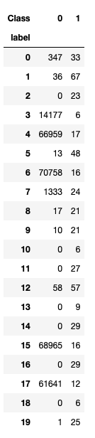
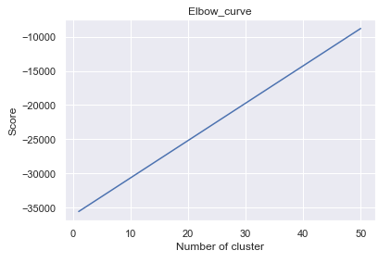
Non-resampled
Resampled
Non-resampled
20 Clusters
Model can’t find appropriate number of cluster
Change technique
Resampled data
Classify on normal data
Improvement in isolating 154 FRAUD
on 492 Fraud
Only one cluster seems relevant
Notes:
Here, using the kmeans algorithm, we first applied it on our non-resampled data. We see on the left corner here that there is really only one cluster that has been able to gather the fraud. Around 40% of all the fraud observations, but with non-fraud observations too. Thus, we thought about performing the same thing but with the resampled data. Then, using the Kmeans model trained with the resampled data, we are predicting the normal non-resampled dataset. We arrive at better cluster, in which we can isolate perfectly 154 Fraud, 31% of the dataset.
The results are a lot better after resampling the data, but we were still not satisfy with the results.
Furthermore, the model couldn’t find the right number of clusters for the dataset, which lead us to think that kmeans might not be suited.

Slide 17
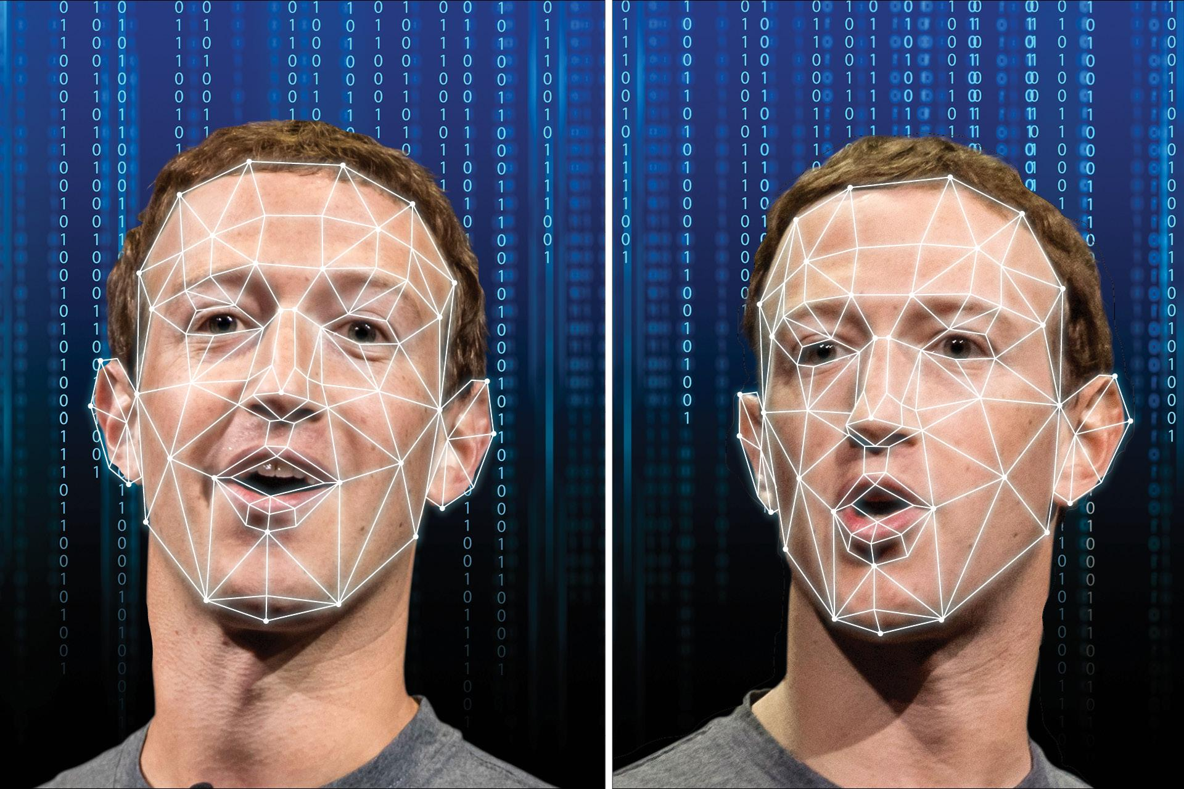
3RD TRY: AUTOENCODERS
LATENT VARIABLE MODEL
Deep Generative Model
Notes:
After trying kmeans, we decided to increase the complexity of the algorithm and use a deep learning architecture called Autoencoders, which are mostly use in Deep Generative Model.
Deep generative model have a popular application with fake video or photos creation.
These Autoencoders are Latent variable model.

Slide 18
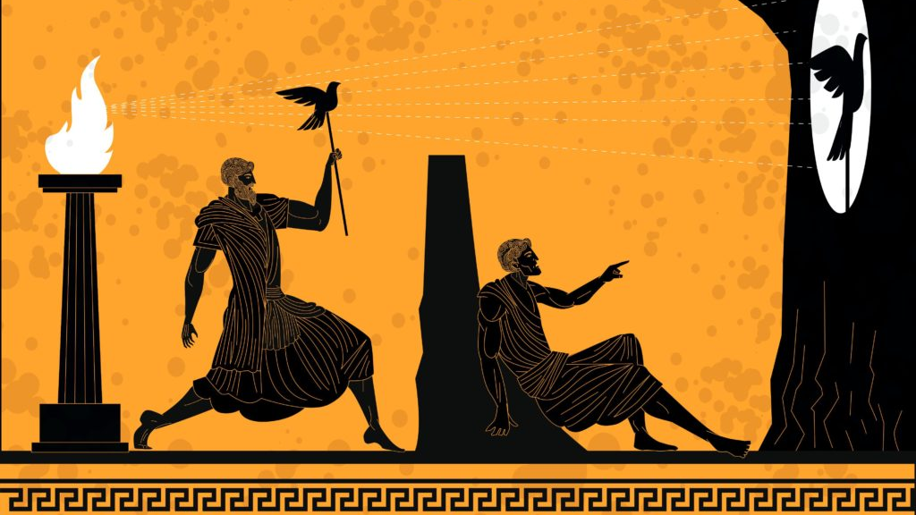
What is a LATENT VARIABLE?
Dataset
Latent space
Notes:
So what are these latent variable model?
The myth of the cave is a great example to illustrate what a latent variable is.
So what do those prisoners see is shadows of real object behind their heads. They are not seeing the actual object. The shadow for them are the observe inputs, but in truth, there are real objects behind them that are casting the shadows into the wall.
Those objects are liked latent variables , they are the underlying variables that are governing some behavior but that we cannot directly observe, we only see what's in front of us. They're the true explanatory explanator factors that are resulting in some behavior.
Our goal in generative modeling is to find ways to actually learn what these true explanatory factors, these underlying latent variables can be. All that using only the observations

Slide 19
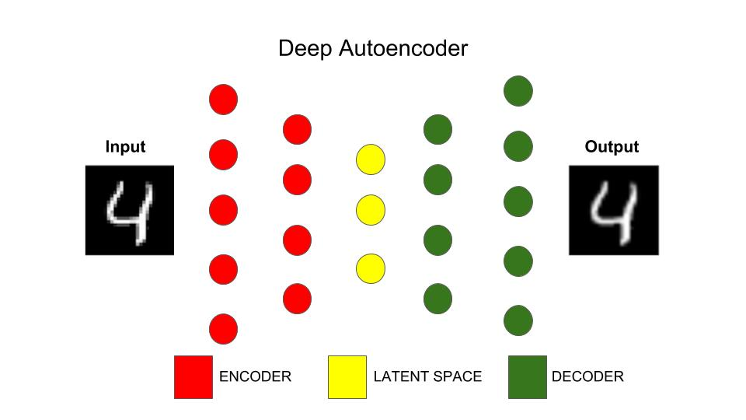
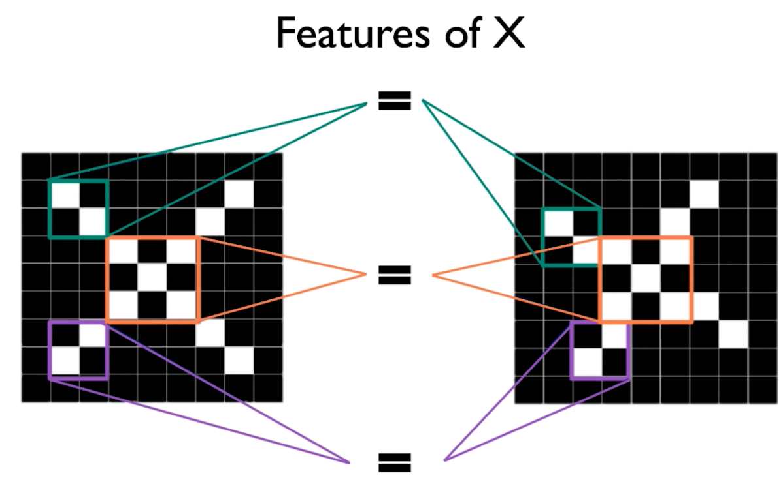
THEORY
Encoder: “the process that produce the “new features” representation from the “old features” representation and decoder the reverse process”
Encoder learns to map input x to a lower dimensional space z
The Decoder role is to reconstruct the image using these features learn
Notes:
Now let’s have a surface dive into autoencoders.
As I said, autoencoders are generative model, thus they can generate image from their inputs. The encoder is a Neural Network as you have seen in class, and the decoder is another Neural network. These two Neural network are then ensemble together to form the Autoencoders. This is why we refer to those kind of model as an “architecture”, as you ensemble multiple model together.
Encoder
Let’s start with the first part of the architecture. The encoder is an unsupervised learning approach for learning a lower dimensional space feature representation from unlabel training data. We pass our input through deep neural network layer which in turns learns to map input x to a lower dimensional space z , who can be call feature space.
Features of X
This image on the left called features of X represent the learning of the decoder. To fully grasp how those the Neural network learn the features of an Image, you would need to understand how a convolutional neural network work. But in surface, a neural network learn in a hierarchical way, here the model is learning that an X as 4 activated pixel in the middle, thus when he sees an X who as been hand-written, he can identify using the learned features.
Latent Space
For the latent space, Z is important because we are able to build a compression of the data, moving from the high dimensional space to this lower one. The more dimension we give to our latent space, the better resolution of our feature we will have. Some information can be loss during the process (in the latent space) meaning that the decoder will have to do without.
Decoder
On the other side, there is the decoder which role is to reconstruct the image using these learned features into the latent variables.
Objective
We are looking for the best encoder decoder pair, which is the pair that keeps the maximum of information when encoding and, so, has the minimum of reconstruction error when decoding..
Apply to our dataset
Applying this to our dataset. The encoder is learning the features (patterns) of normal transactions. And using those features, the model is able to recreate those credit transactions.

Slide 20
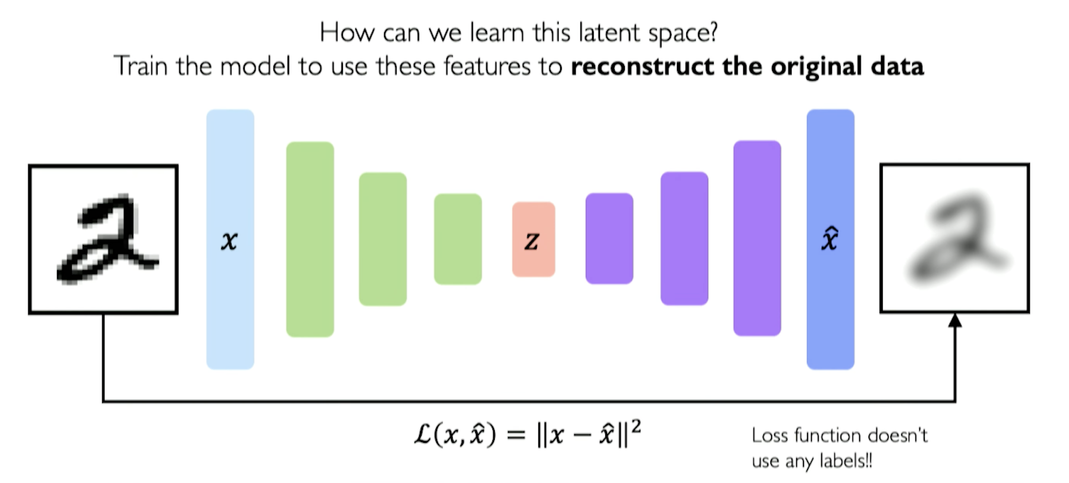
TRAINING
We are trying to minimize the distance between the inputs and the outputs.
(Input – Output)^2 = MSE
In the case of picture, the loss is just the difference in pixel
Loss function -> No labels
Notes:
How does the model learn?
So, how those the model learn? Because we don't have any labels, we have to find a way of training our network. So we maximize with what we have by using our original input to train the network in learning the underlying features of it.
Another way to put it. Is that we learn the best encoding-decoding scheme using an iterative optimisation process. So at each iteration we feed the autoencoder architecture with some data, we compare the encoded-decoded output with the initial data and backpropagate the error through the architecture to update the weights of the networks. Thus, the autoencoder creates a bottleneck of data that ensures only the main structured part of the information can go through and be reconstructed.
Loss function
In the case of picture, the loss is just the difference in pixel

Slide 21

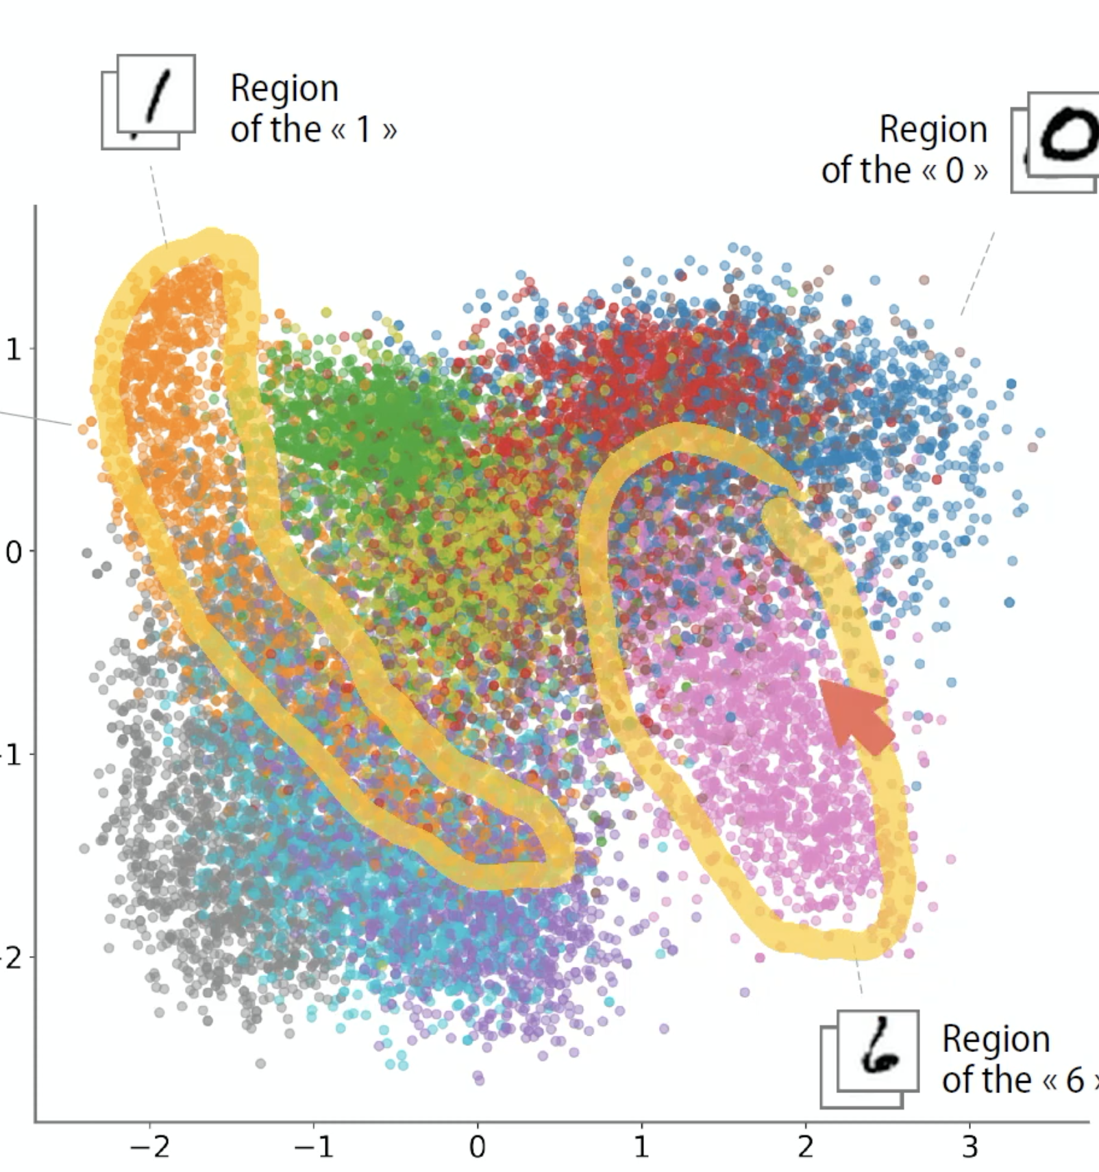
REAL LIFE EXAMPLE
Notes:
Here is a real life example, it might not be the best but I believe it brings intuition behind autoencoders.
Here we right a number, which is the inputs and the algorithm can identify this number because of his features and then output his prediction as a text number.
Anomaly detection
Imagine this scenario. Here we define this zone as a 1, one day you bring an observations and she fall in the top right, which is not normal because usually it always end up in this region. And this is why Autoencoders are good for anomaly detection, which is what we are doing in fraud detection. We give to our model a transaction, and when he tries to reconstruct it, the observations doesn’t end up in the region that it should end up. Thus, we might think that this transactions is a fraud as she does not correspond to the normal features and patterns of the non-fraud transactions.

Slide 22
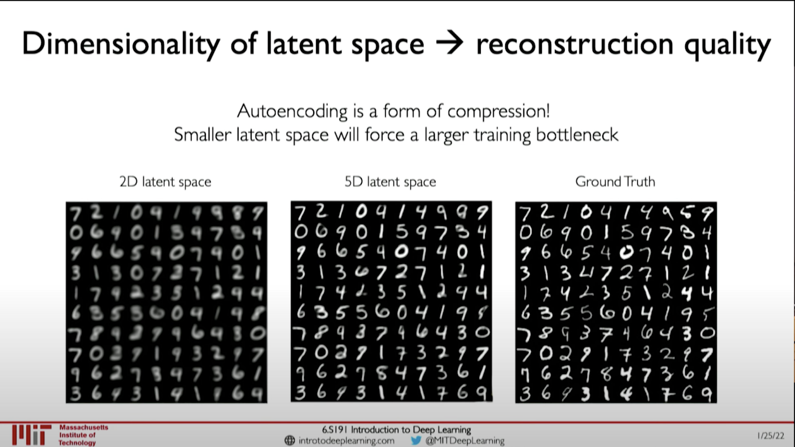
LATENT SPACE VISUALIZATION
Our Latent Space!
Notes:
As I said a bit earlier, The more dimension we give to our latent space, the better resolution of our feature we will have. And the less information we are losing about our inputs.
On the top right is the latent space of our dataset, in blue are the fraud transactions. We see the difficulty to perform cluster analysis as the observations are not concentrate in the same zone.

Slide 23
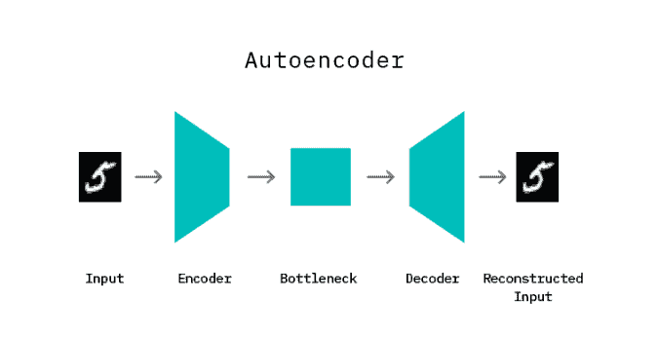
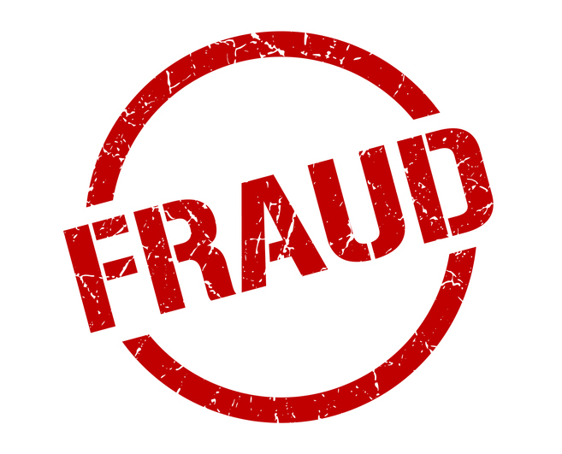
CONCEPT
Training Phase
Fraud detection Phase
Training with non-fraud observation
Using the same model that has learned to recreate non-fraud events. We give him FRAUD events.
WE WILL KNOW WHEN IT WILL BE A FRAUD WHEN THE MODEL WILL HAVE A HIGH RECONSTRUCTION LOSS
Notes:
Given all of this information, now how can we apply this on our dataset to perform fraud detection?
First, in the training phase, we are solely giving non-fraud observations to our model, so that the latent space only account for the features of the non-fraud transactions.
We then give as inputs fraud transaction to this model trained with non-fraud transactions and we asked it to reconstruct those inputs given the learned features from the latent space. As those observations are anomalies, we believe that the model will not be able to reconstruct them easily and that the reconstruction lost will be high.
Thus: WE WILL KNOW WHEN IT WILL BE A FRAUD WHEN THE MODEL WILL HAVE A HIGH RECONSTRUCTION LOSS

Slide 24
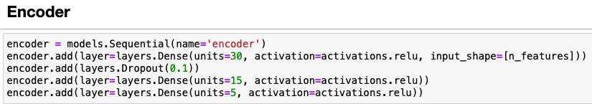
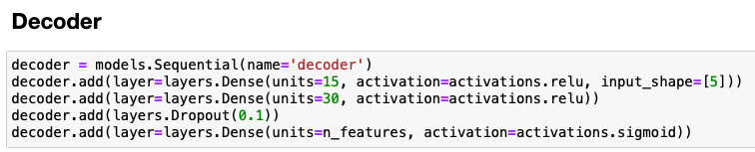
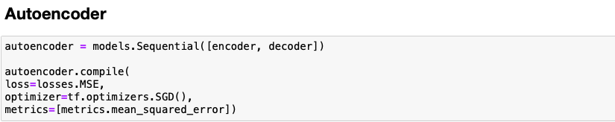
IMPLEMENTATION
Training: 80 – 20 Non-fraud Observations
Prediction on 492 Fraud Observations
Notes:
Here is the implementation on python.
Only 3 layers, with the same numbers of neurons as inputs and outputs.
A dropout layer and the assembling of the encoder and decoder to form the autocender. Then we compile the model and use it to make the prediction on the fraud observations.

Slide 25
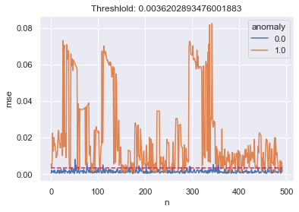
RESULTS
Using a threshold of 95 percentile
Every observations that has a RMSE higher than the threshold is considered a Fraud.
Signaling fraud while minimizing disrupting customers with false positives is one of our objective.
Although, 16% of the time we are predicting it is not a fraud while it is, which is a high rate. Usually we would investigate the tradeoff between augmenting the false positive and decreasing false negative, as it is more costly to not flag a transaction as a fraud while it is one, over simply flag it as a fraud and disrupt our customer. But, here we can’t investigate the tradeoff between false positive and false negative as our prediction doesn’t include false positive. What we should do is play with the 95% threshold and improve the model through tuning.
This graph represent the 492 Fraud observations
Classification rate for Fraud transactions: 84%
16% of False Negative (Predict is not a fraud while it is one)
Notes:
Here are our results, we use a threshold of 95 percentile to classify the fraud of the non-fraud. The 95 percentile is compute using the MSE of the reconstruction loss on the non-fraud transactions.
If our MSE is larger then the 95 percentile threshold, we identify the observations as a fraud, else not. Here we can see that we rigthly classify 84% of the frauds transaction. Which is a lot better than what we have been able to achieve in the previous 2 try.

Slide 26
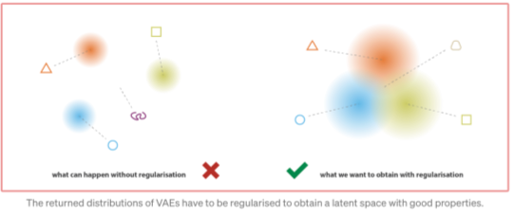
FINDINGS AND IMPROVEMENTS
Use of Variational Autoencoders
Difficulty to tune and to converge
Organize in a smart way the latent space
Avoid overfitting due to regularization
Hyperparameter tuning
Notes:
To conclude, we did attempt to use more complex architecture like Variational Autoencoders, which are more efficient at organize the latent space. But the algorithm had difficulty to converge and decide not to present it. Even tho the predictions were really promising.
We could also spend a lot more time doing hyperparameter tuning on our existing Autoencoders.
We are very please with the results and the learning opportunity.
Thank you from all of us, do you have any questions.

